Slide 1
Reproducing reference performance
reco_command1 = "{0}/eicdirc ".format(pars.dircmacrosTopDir) + "-i " + inputfile + "-u " + lutfile + "-r 2 -timecut {} -v 2 -e 0 -trackingres 0.0005 -x mix_pik -timeres {}"
reco_command2 ="{0}/eicdirc".format(pars.dircmacrosTopDir) + "-i " + inputfile + "-u " + lutfile + "-r 4 -timecut {} -v 2 -e 0 -trackingres 0.0005 -x mix_pik -timeres {}
reco_command3 = "{0}/eicdirc ".format(pars.dircmacrosTopDir) + "-i " + inputfile + "-u " + lutfile + "-pdf " + pdffile + "-r 2 -timecut {} -v 2 -e 0 -trackingres 0.0005 -x mix_pik -timeres {}"
Events per Job = 50000
sim_command = "{0}/eicdirc -o ".format(pars.macrosTopDir) + outputFile + "-r 0 -theta {0} -x \"mix_pik\" -p 6.0 -w 0 -g 1 -h 11 -c 2031 -l 3 -trackingres 0.0005 -v 0 -gz 1 -ev 0 -b 1 -e {1}".format(inputTheta, pars.nEventsPerJob)
Timecut = 0.5, 0.05 and 0.25 ns
Timeres = 200, 100 and 10 ps

Slide 2
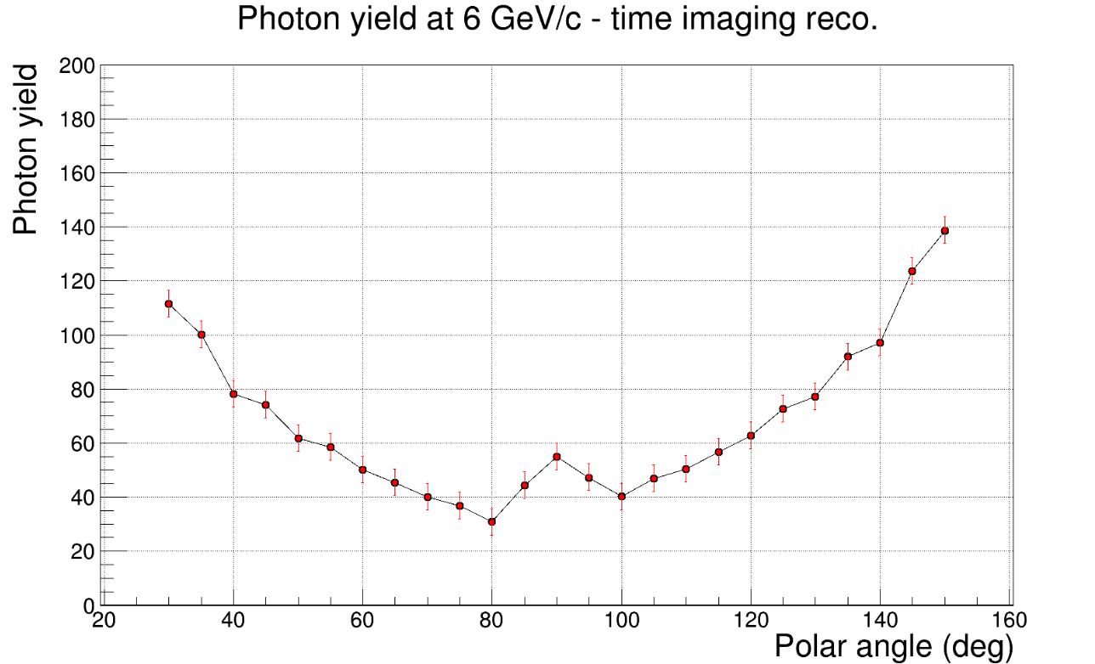
Timecut 0.5 and timeres 0.1
Roman
Imran

Slide 3
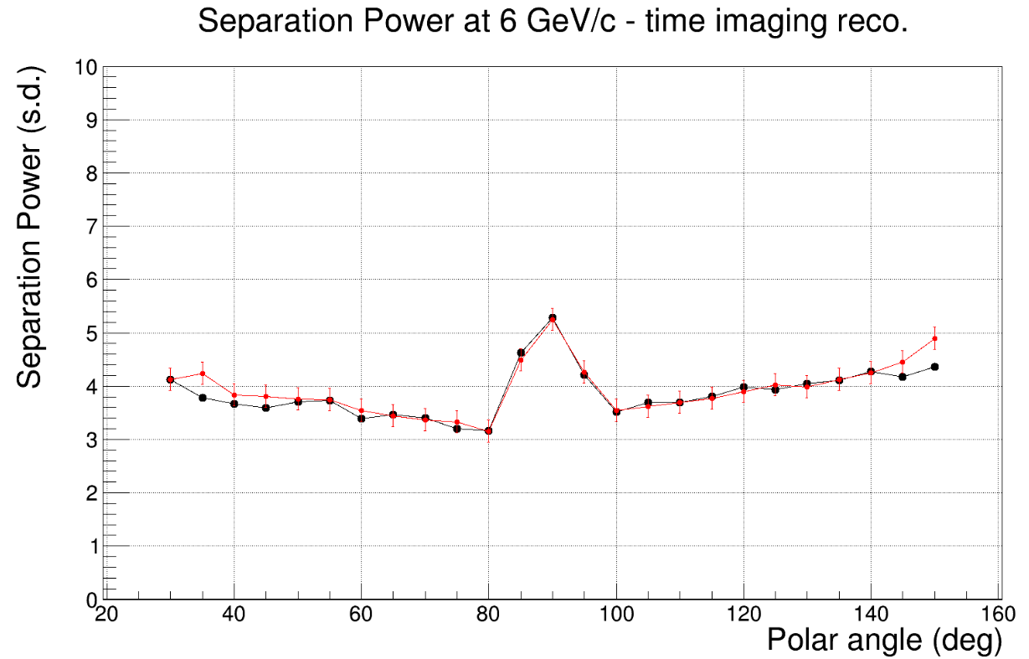
Timecut 0.5 and timeres 0.1

Slide 4
Timecut 0.5 and timeres 0.2

Slide 5
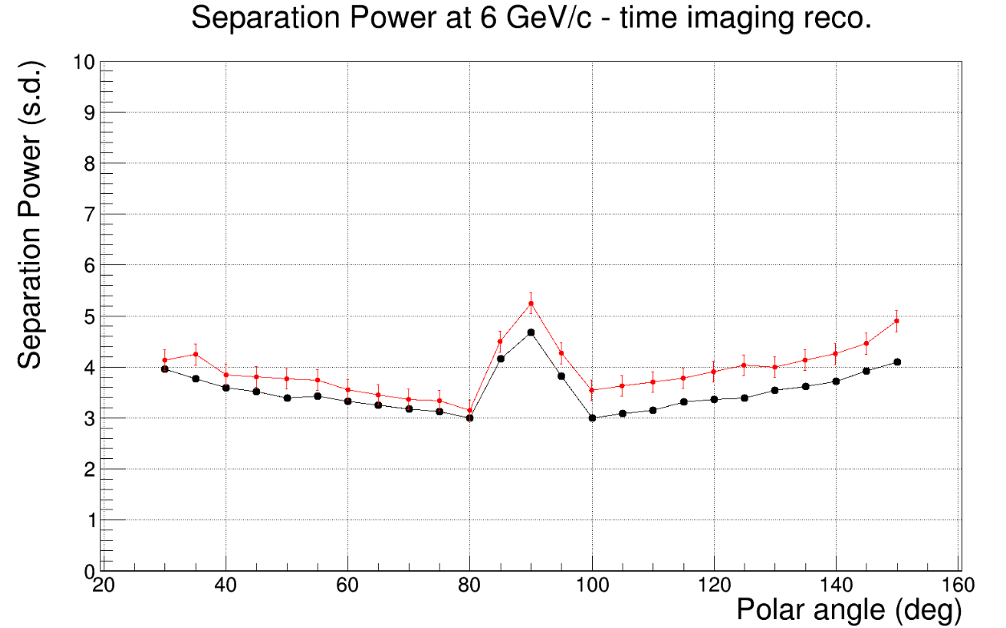
Timecut 0.5 and timeres 0.2

Slide 6
Timecut 0.5 and timeres 0.01

Slide 7
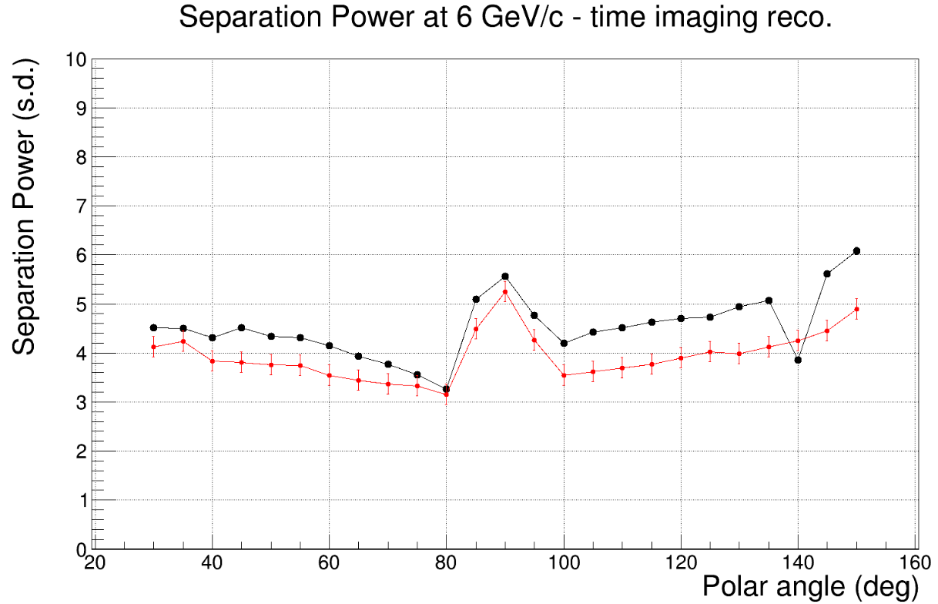
Timecut 0.5 and timeres 0.01

Slide 8
Timecut 0.05 and timeres 0.1

Slide 9
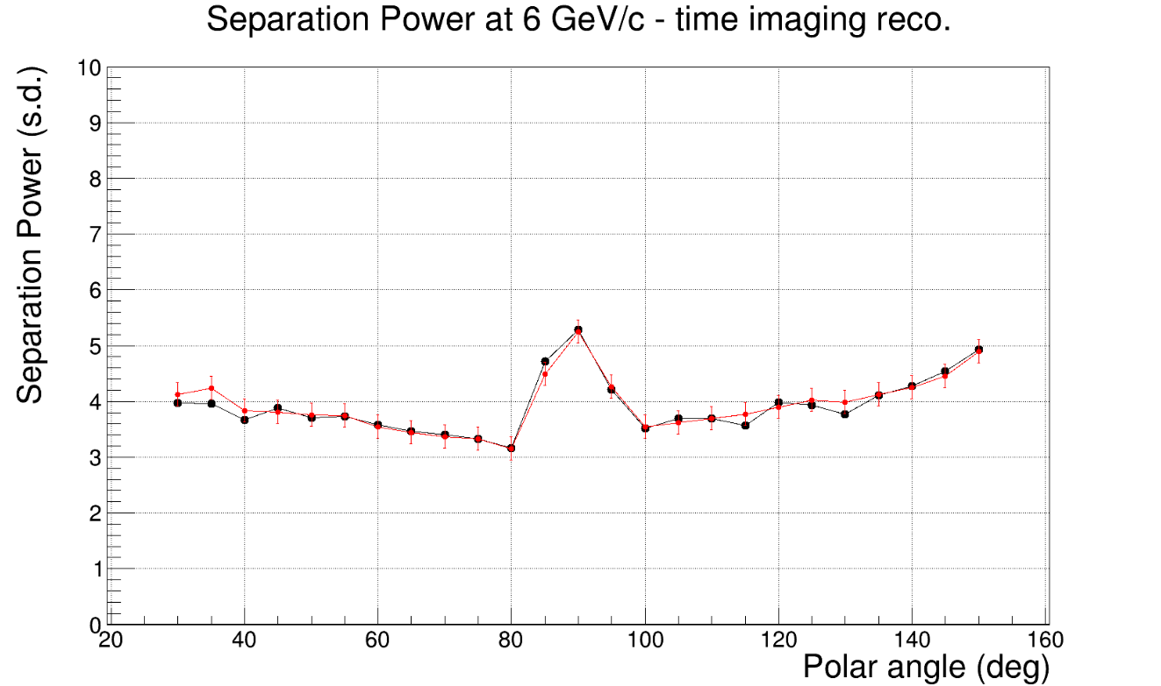
Timecut 0.05 and timeres 0.1

Slide 10
Timecut 0.05 and timeres 0.01

Slide 11
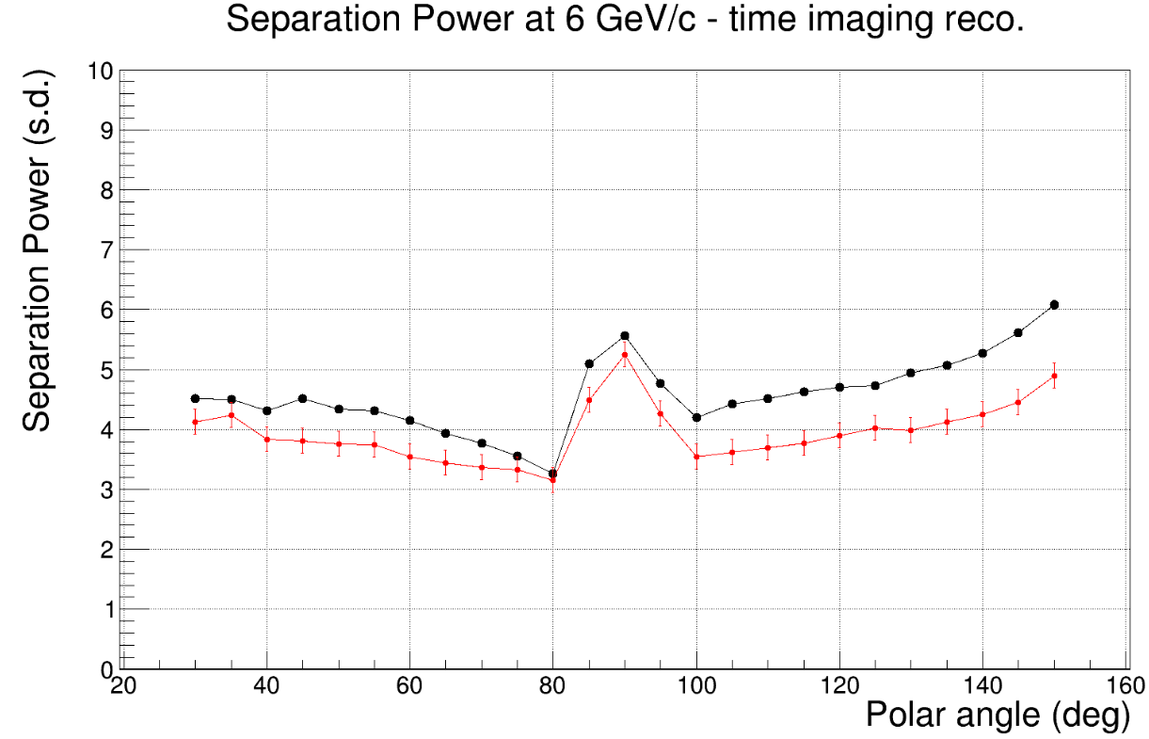
Timecut 0.05 and timeres 0.01

Slide 12
Timecut 0.05 and timeres 0.2

Slide 13
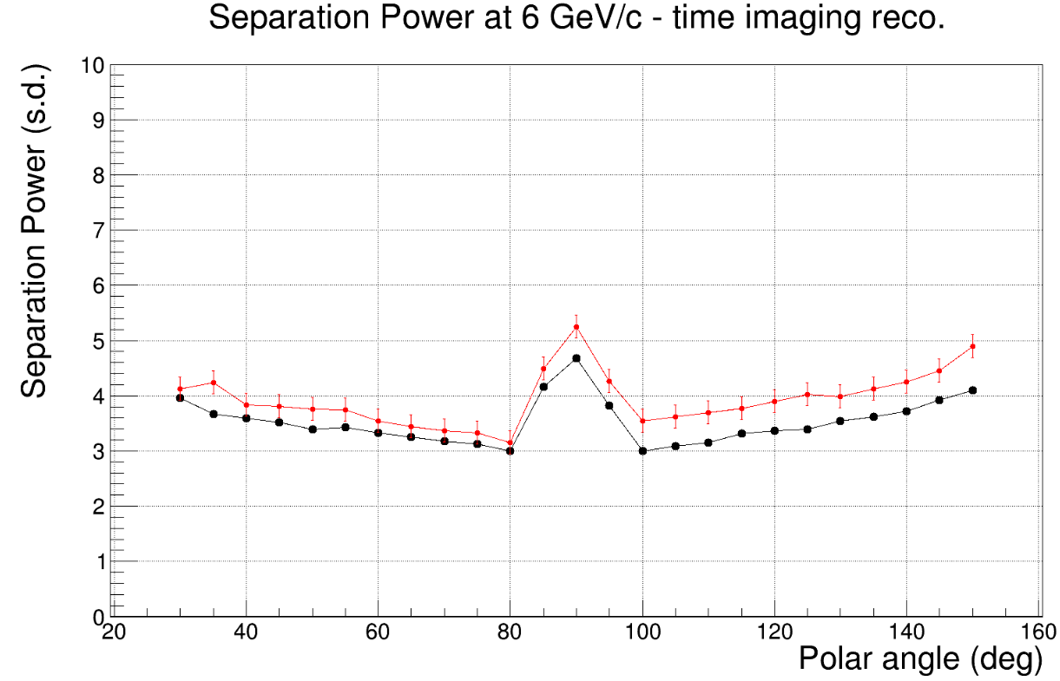
Timecut 0.05 and timeres 0.2

Slide 14
Timecut 0.25 and timeres 0.1

Slide 15
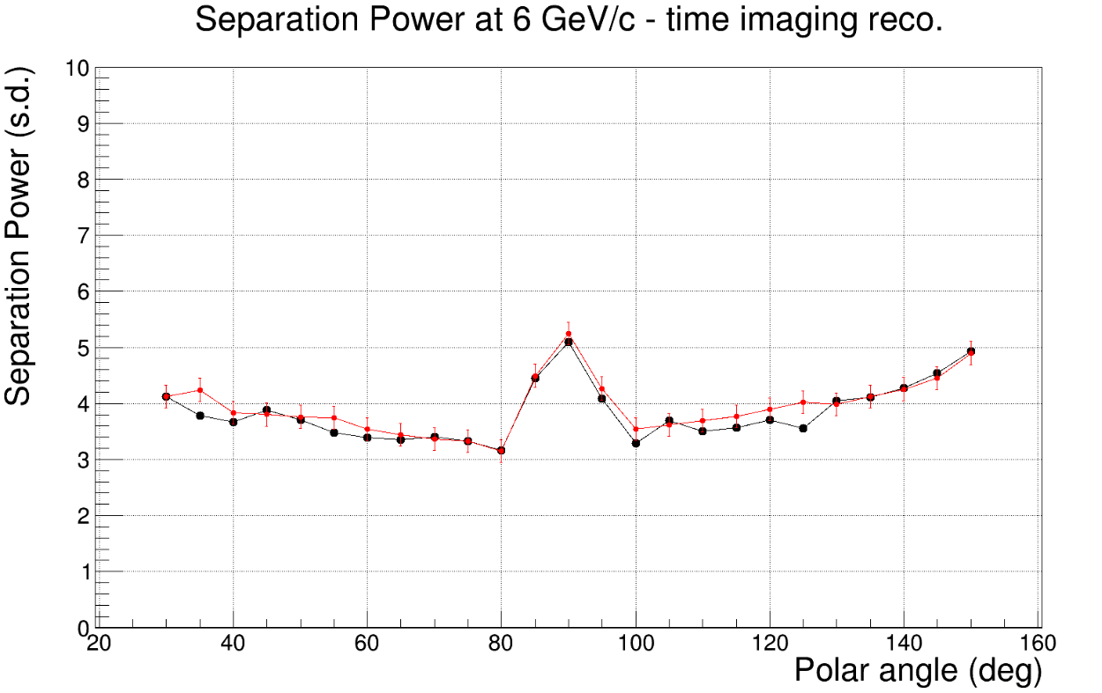
Timecut 0.25 and timeres 0.1

Slide 16
Timecut 0.25 and timeres 0.01

Slide 17
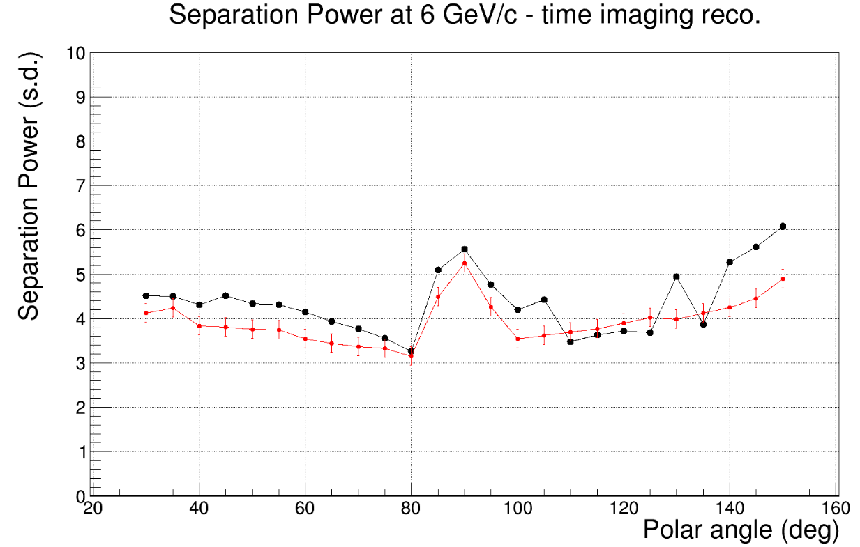
Timecut 0.25 and timeres 0.01

Slide 18
Timecut 0.25 and timeres 0.2

Slide 19
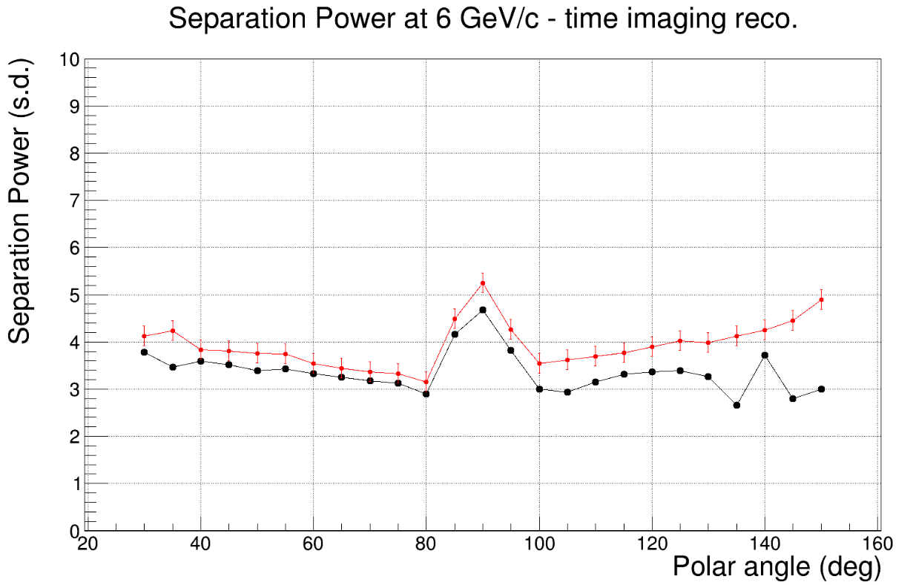
Timecut 0.25 and timeres 0.2

Slide 20
Geometric Reconstruction
Events per job = 4000
Timecut = 0.5, 0.05 and 0.25 ns
Timeres = 0.2, 0.1 and 0.01

Slide 21
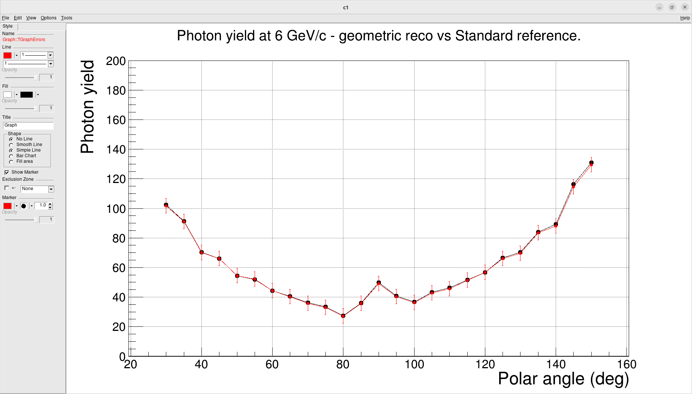
Timecut 0.5 and timeres 0.1

Slide 22
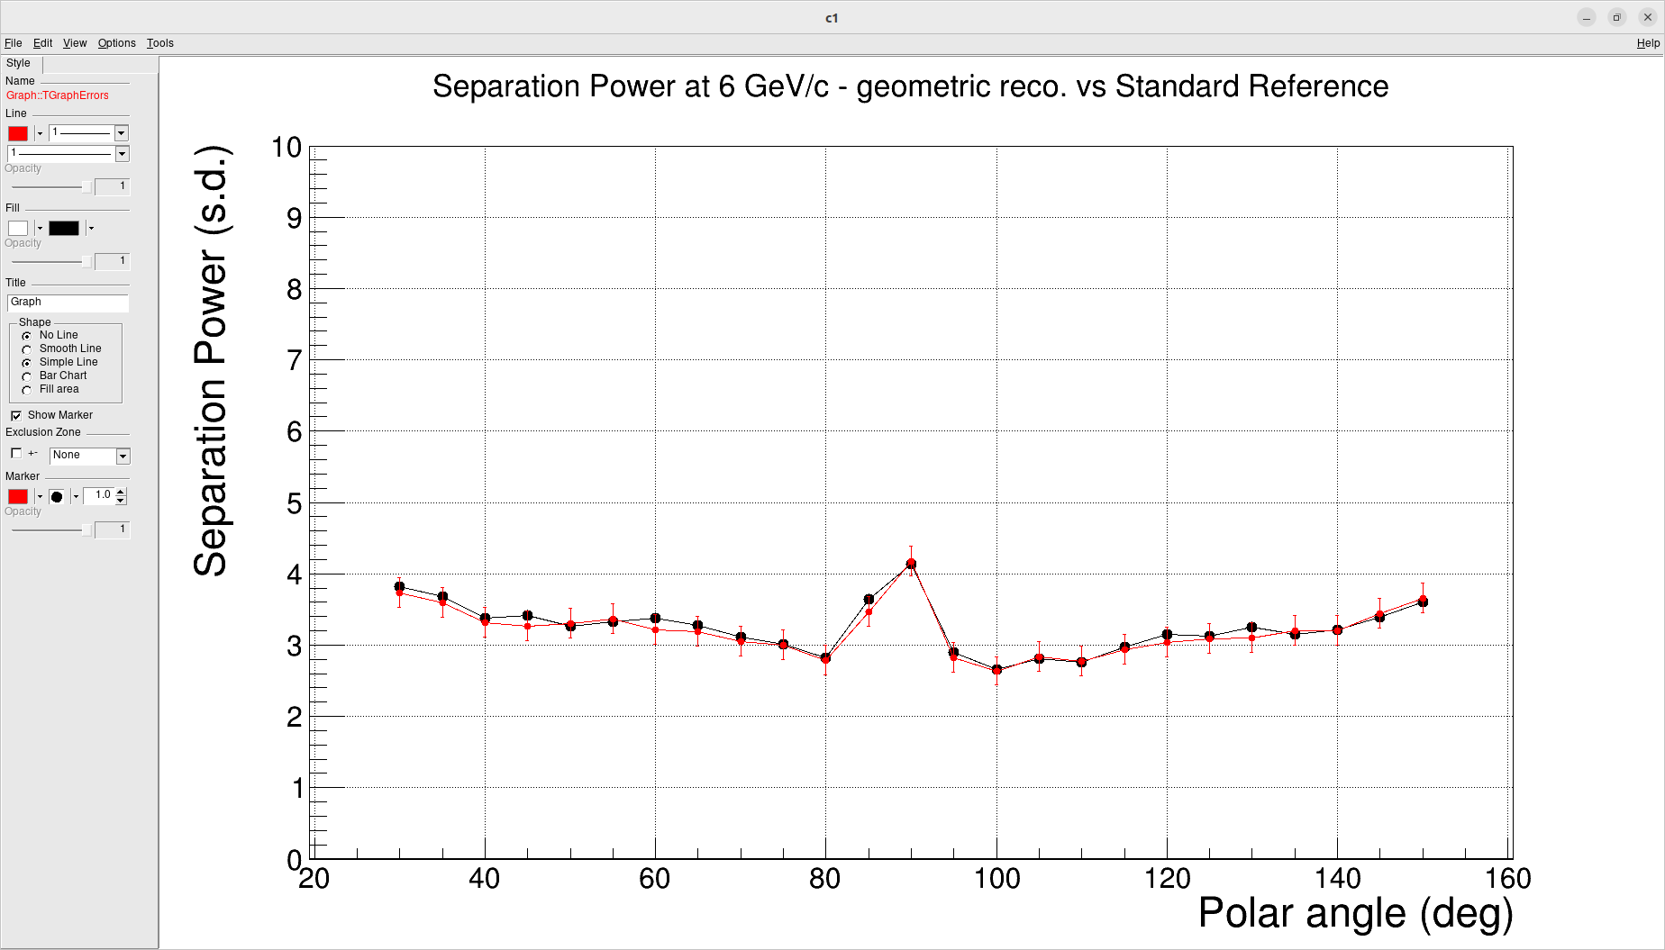
Timecut 0.5 and timeres 0.1

Slide 23
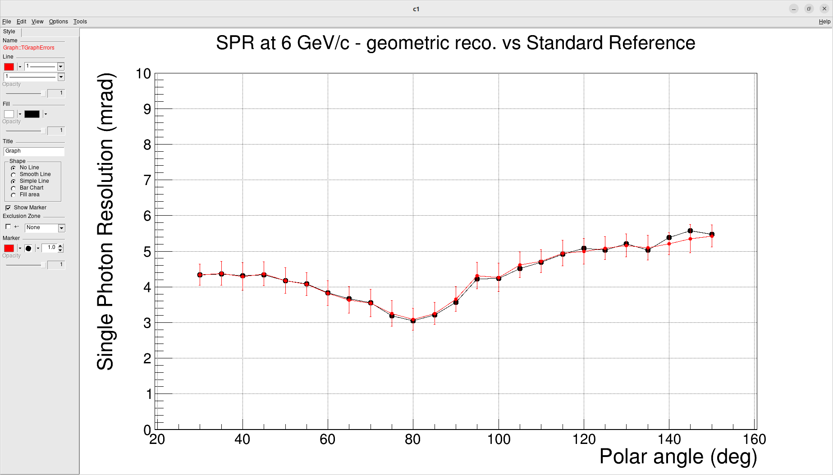
Timecut 0.5 and timeres 0.1

Slide 24
Timecut 0.5 and timeres 0.01

Slide 25
Timecut 0.5 and timeres 0.01

Slide 26
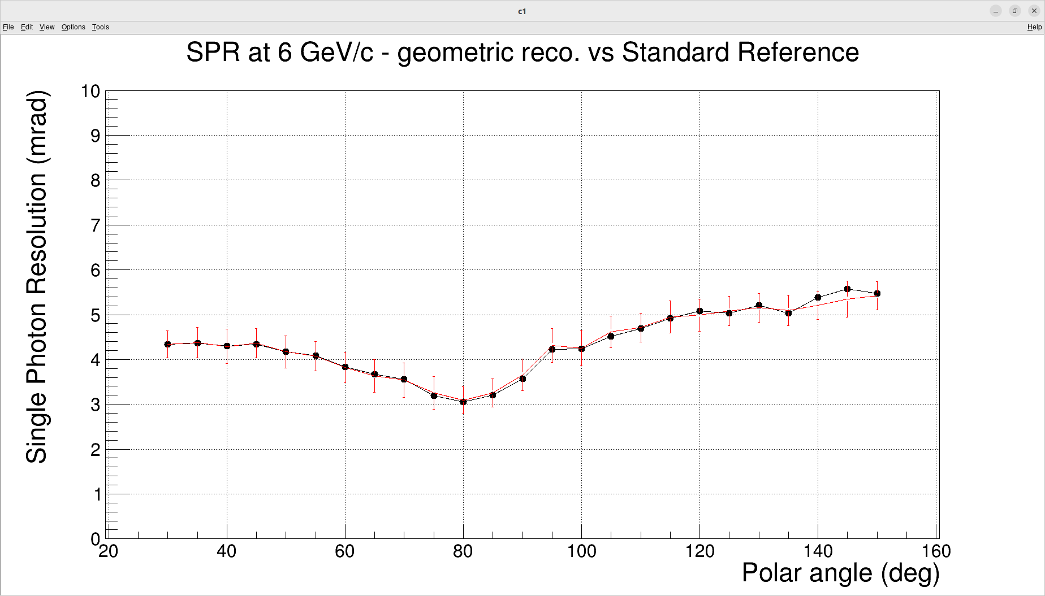
Timecut 0.5 and timeres 0.01

Slide 27
Timecut 0.5 and timeres 0.2

Slide 28
Timecut 0.5 and timeres 0.2

Slide 29
Timecut 0.5 and timeres 0.2

Slide 30
Timecut 0.25 and timeres 0.2

Slide 31
Timecut 0.25 and timeres 0.2

Slide 32

Timecut 0.25 and timeres 0.2

Slide 33
Timecut 0.25 and timeres 0.1

Slide 34
Timecut 0.25 and timeres 0.1

Slide 35
Timecut 0.25 and timeres 0.1

Slide 36
Timecut 0.25 and timeres 0.01

Slide 37
Timecut 0.25 and timeres 0.01

Slide 38

Timecut 0.25 and timeres 0.01

Slide 39
Timecut 0.05 and timeres 0.2

Slide 40
Timecut 0.05 and timeres 0.2

Slide 41
Timecut 0.05 and timeres 0.2

Slide 42
Timecut 0.05 and timeres 0.2
Timecut 0.05 and timeres 0.1

Slide 43
Timecut 0.05 and timeres 0.1

Slide 44
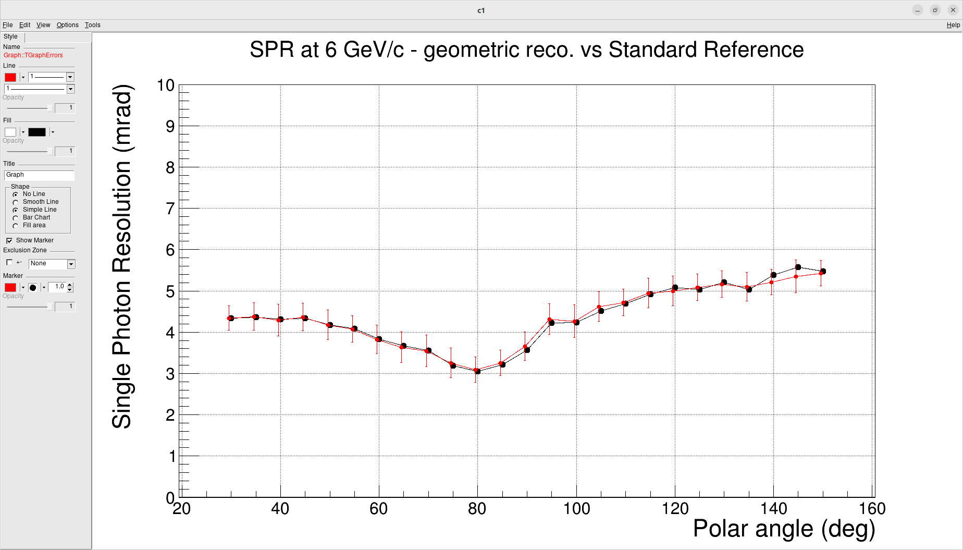
Timecut 0.05 and timeres 0.1

Slide 45
Timecut 0.05 and timeres 0.01

Slide 46
Timecut 0.05 and timeres 0.01

